Slide 1
SQ4003 Data Management Week 5 Tuesday 28th October 9.30am – 1.00pm Teaching Lab 1

Slide 2
Data Management
Learning Outcomes:
By the end of this session, students will be able to:
Consider effective uses of Excel as a data management tool.
Explore operations within Excel (e.g. entering data into a spreadsheet).
Understand functionalities within Excel (e.g. how to create charts through an Excel spreadsheet).
Use Generative AI to create outputs related to the functionality of Microsoft Excel.
Utilise their presentation skills to convey information to their peers.
Explore the concepts of tidy and fair data management principles.
Understand the support available to students through the HAU Academic Guidance team.

Slide 3

Using Excel

Slide 4
Using Excel Student Task 1
Pairs discussion:
What do you already know about Microsoft Excel?
What features / functionality have you already used?
When have you already used Excel?
Where have you already used Excel?
Why have you already used Excel?

Slide 5
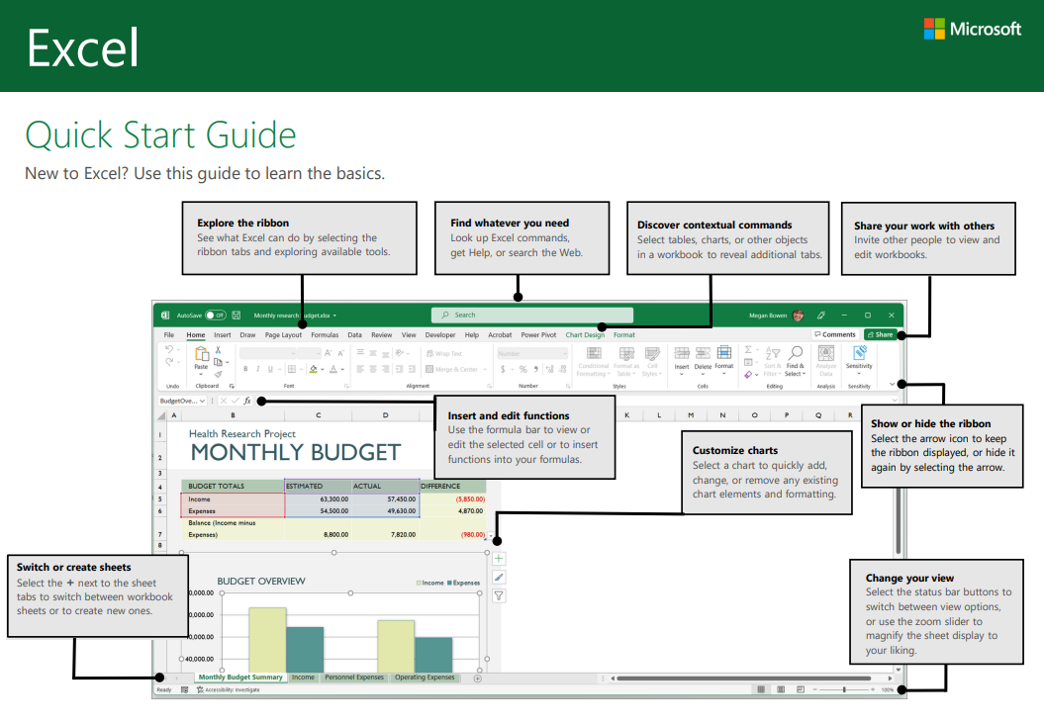
Using Excel Student Task 2
Working in pairs:
Download Handout from SQ4003 module Moodle page: Module: Professional and Study Skills | Virtual Learning Environment
Read and Glean:
Key points / concepts from the handout.
Be prepared to share your feedback

Slide 6

Using Excel Student Task 3
Introduction to Microsoft Excel:
Individual task:
Make a note of what you think are KEY concepts about using Excel and any NEW information for you.
Introduction to Microsoft Excel: Structure of a Microsoft Excel Spreadsheet - YouTube

Slide 7

Using Excel Student Task 4
Working in pairs:
Make a list of real-world uses for Excel
What can it be used for …
In the workplace
At home
For leisure (pursuits)

Slide 8

Using Excel Student Task 5
Working individually,
Make a list of your future potential uses of Excel during your degree studies.
What could you use it for?
What will you use it for?

Slide 9
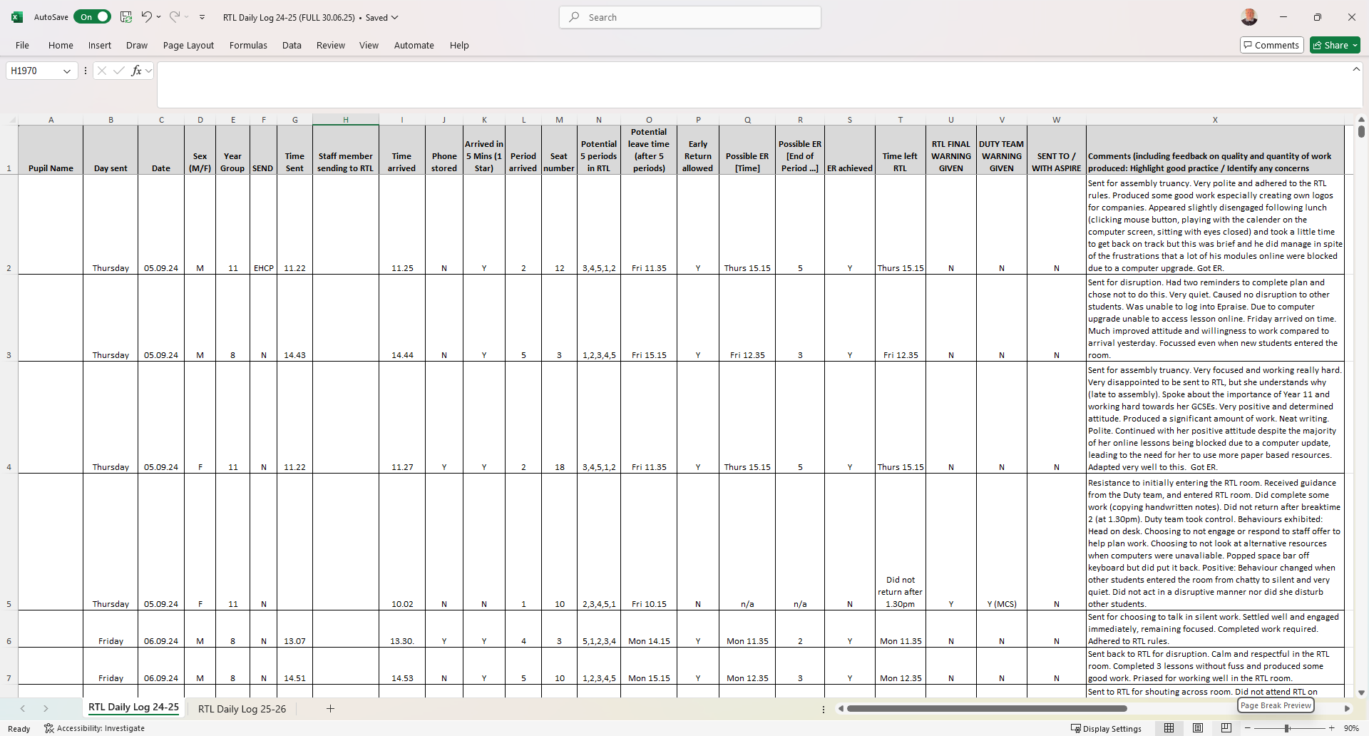
Using Excel
Case Study Example:
BASIC SPREADSHEET FOR RECORDING DATA IN THE WORKPLACE (RTL DAILY LOG)

Slide 10
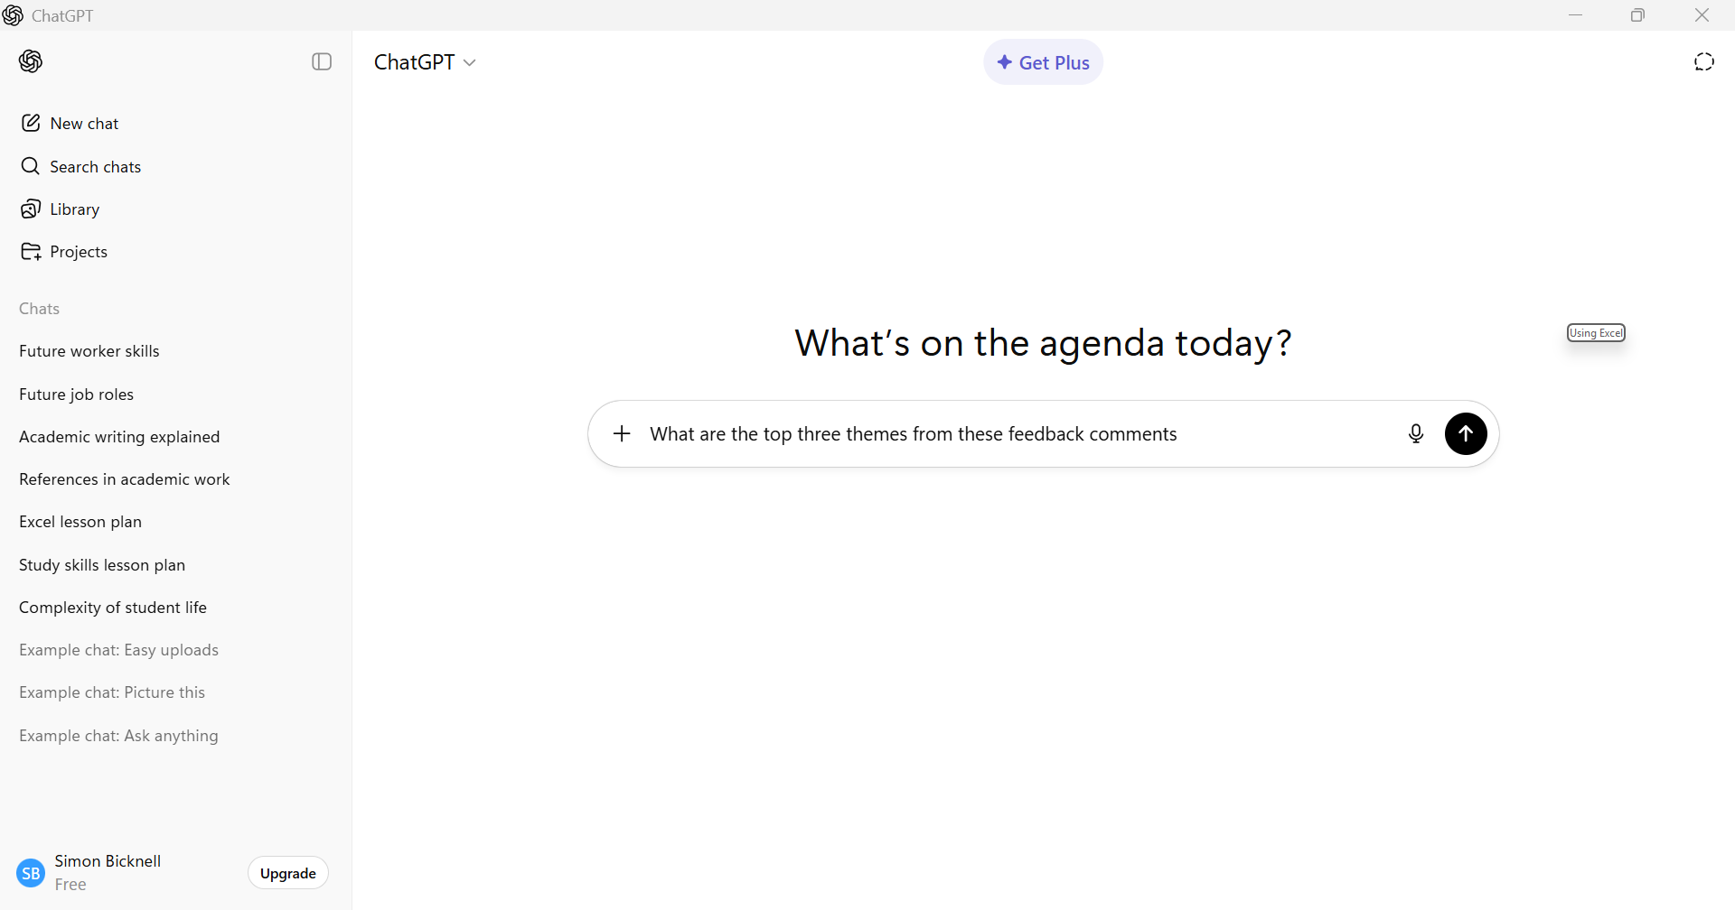
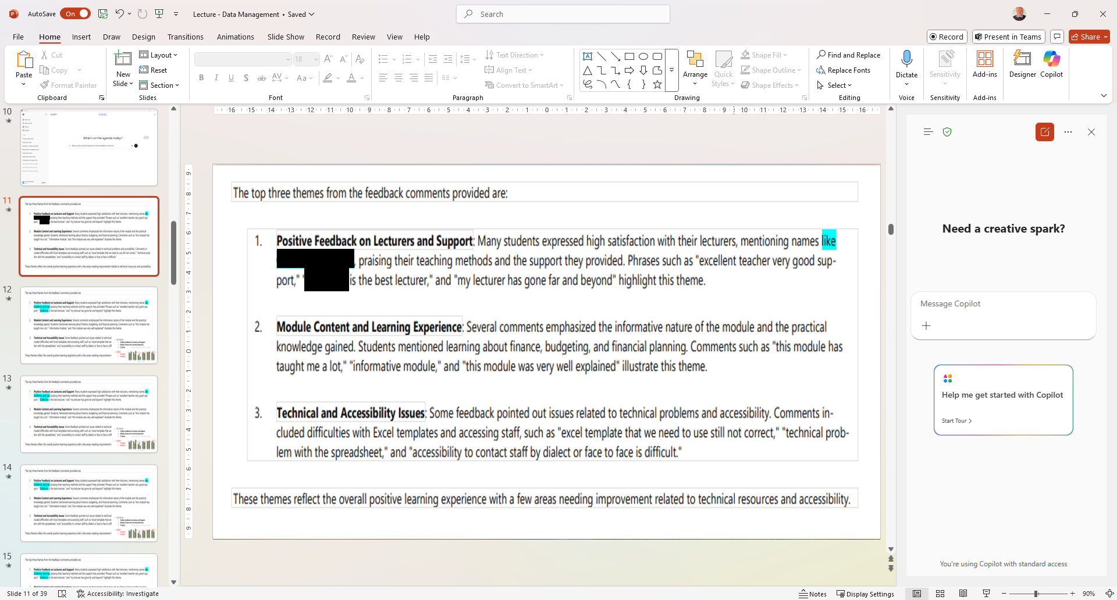
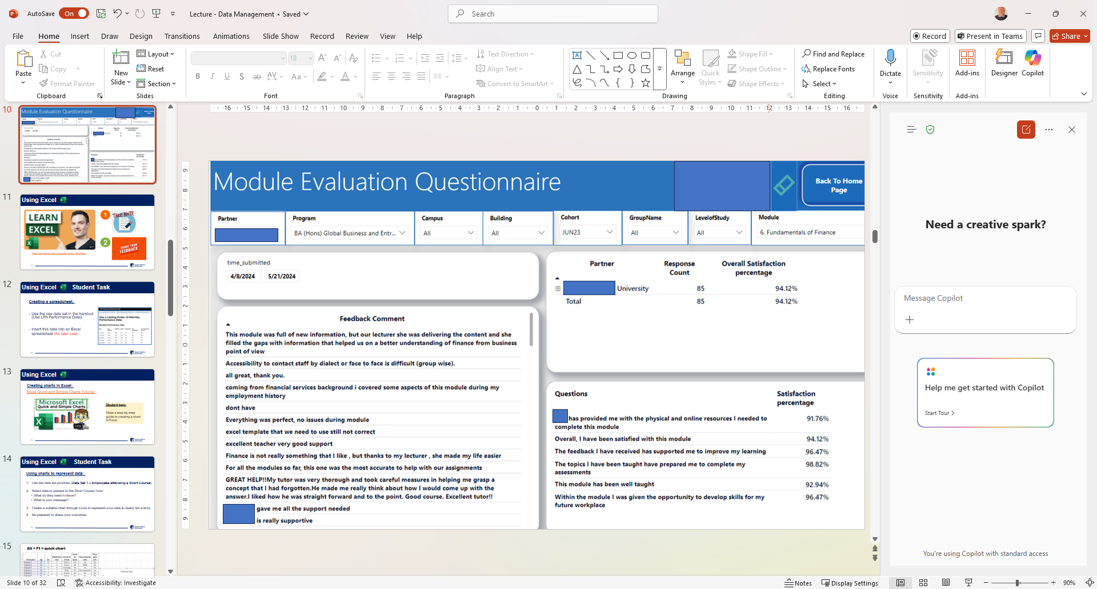
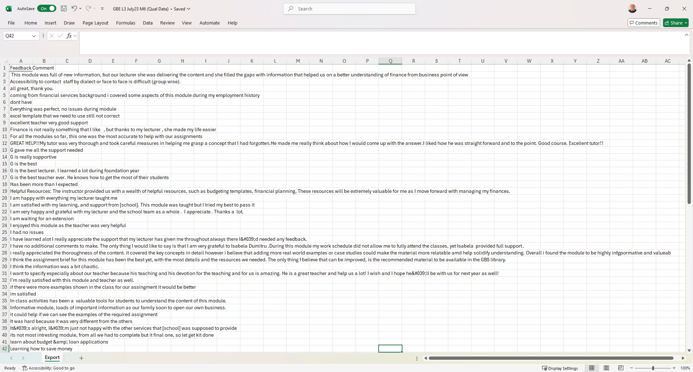
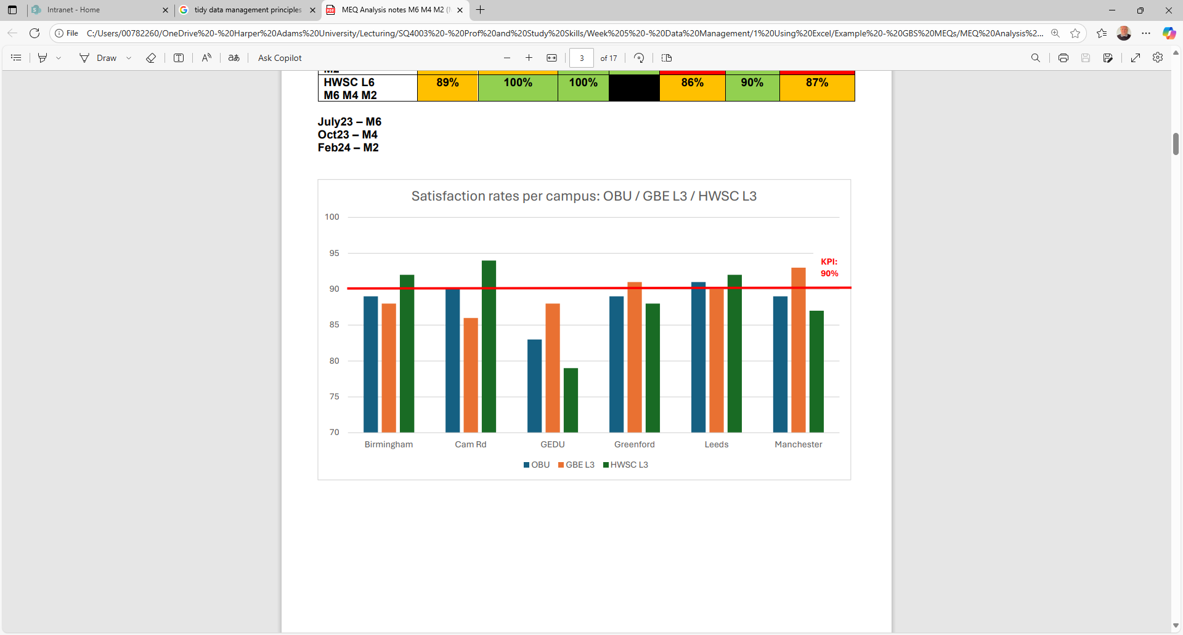
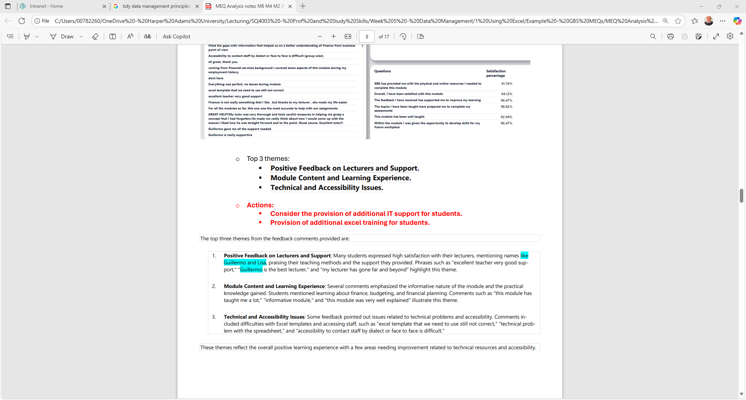
Using Excel
Case Study Example:
Analysis of Module Evaluation Questionnaires (MEQs)

Slide 11





Using Excel Student Task 6
Excel Tutorial for Beginners

Slide 12
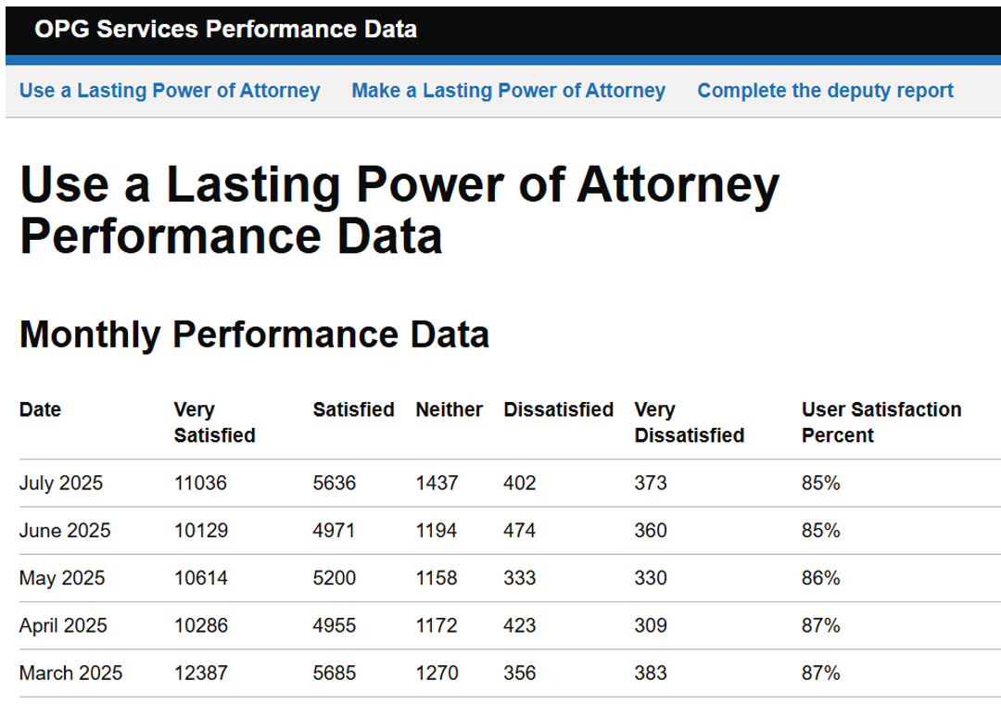
Using Excel Student Task 7
Creating a spreadsheet.
Use the raw data set in the handout (Use LPA Performance Data).
Insert this data into an Excel spreadsheet (for later use).

Slide 13

Using Excel Student Task 8
Creating charts in Excel:
Working in pairs:
Make your own step-by-step guide to creating a chart in Excel.
Excel Quick and Simple Charts Tutorial

Slide 14
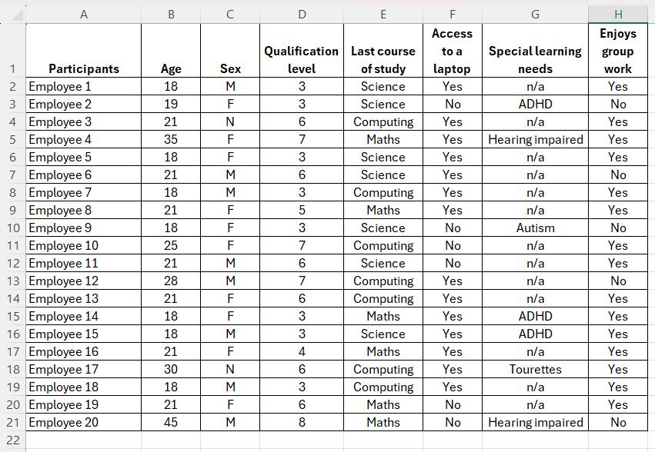
Using Excel Student Task 9
Using charts to represent data:
Use the data set provided (Data Set – ‘Employees attending a Short Course’).
Select data to present to the Short Course Tutor:
What do they need to know?
What is your message?
Create a suitable chart through Excel to represent your data & clearly tell a story.
Be prepared to share your outcomes.

Slide 15
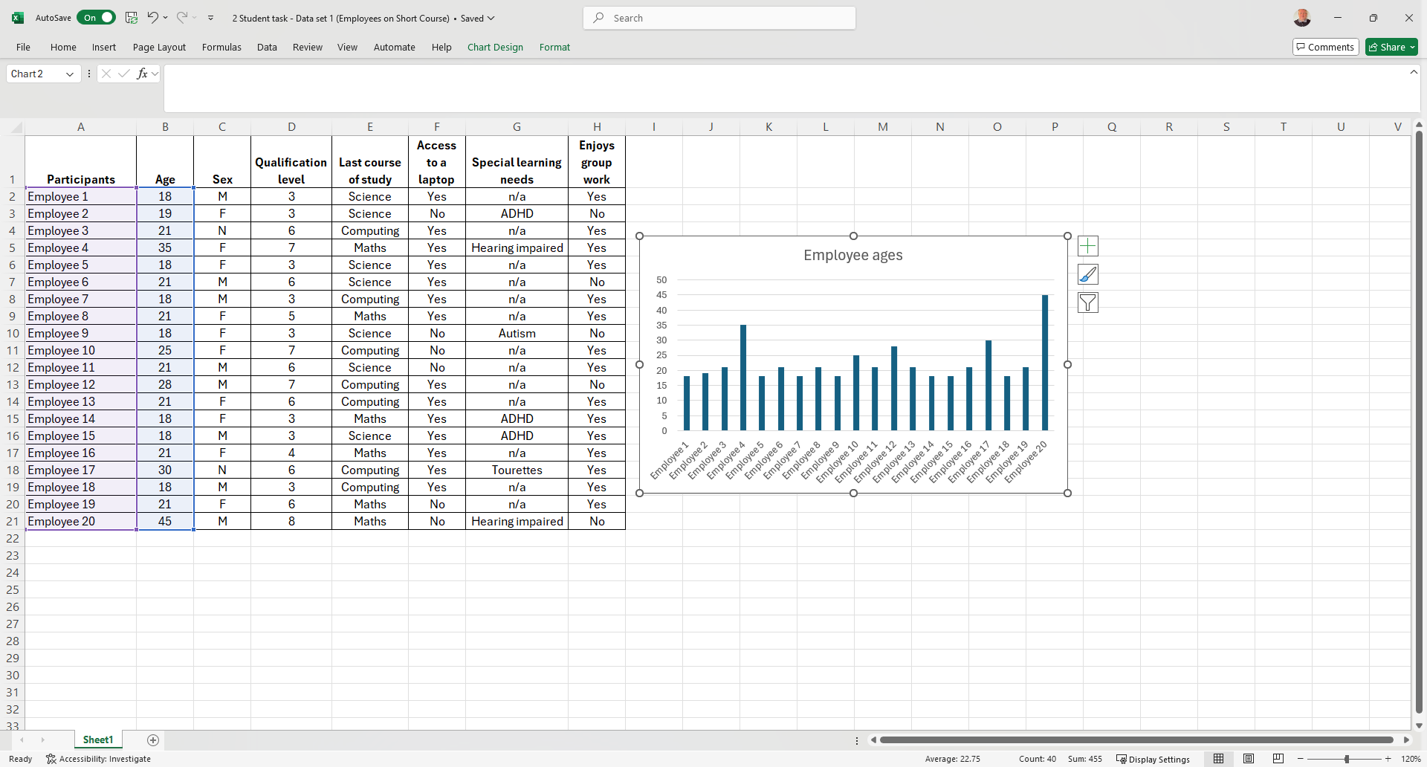
Alt + F1 = quick chart

Slide 16
Using Excel Student Task 10
Using charts to represent data:
Use your ‘raw data’ excel spreadsheet.
Select which data to present in a pictorial format (e.g. Chart, graph)
Create a suitable chart through Excel to represent the selected data / clearly tell a story.
Be prepared to share your outcomes.

Slide 17

Using Excel Student Task 11
Evaluating data in charts and graphs.
Using the handout:
What key messages can you identify from the charts and graphs presented (pp.3-24).

Slide 18
Using Excel Student Task 12
Creating Excel outputs using Generative AI.
Working in pairs:
Select a Generative AI platform to use.
Select a task that can be completed using Microsoft Excel, for example:
Making graphs from datasets.
Using formula for calculations.
Writing a report.
Use Generative AI to provide instructions for your fellow students on how to perform this task.
Use Generative AI to create a handout for your fellow students.
Use Generative AI to create a dataset for your fellow students (if appropriate).
Present your results to the class for feedback and discussion.

Slide 19

What Artificial Intelligence (AI) tools are available to you?

Slide 20

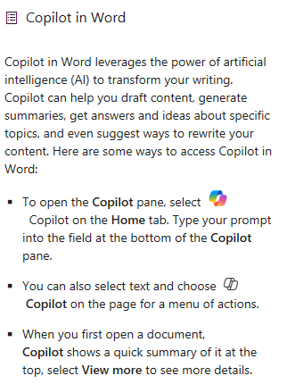
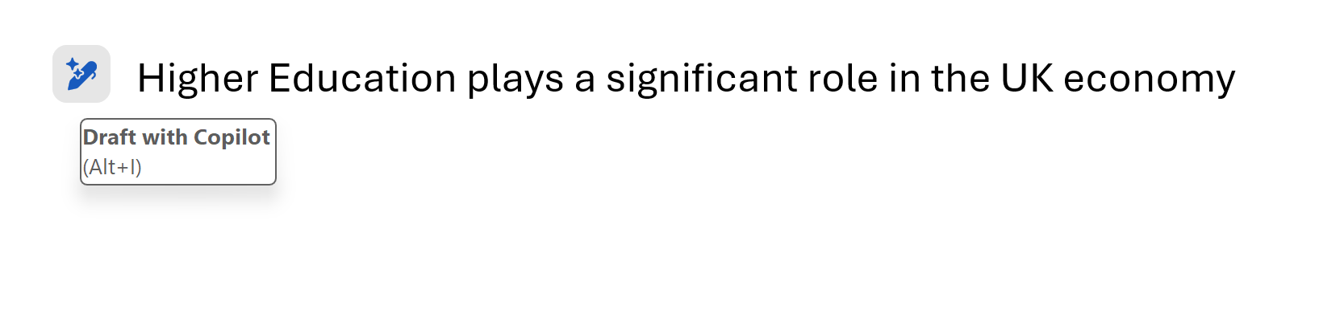

Slide 21
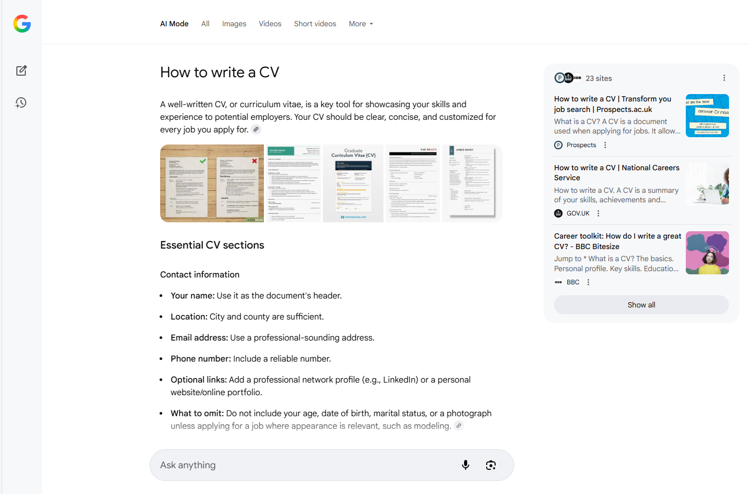


Slide 22
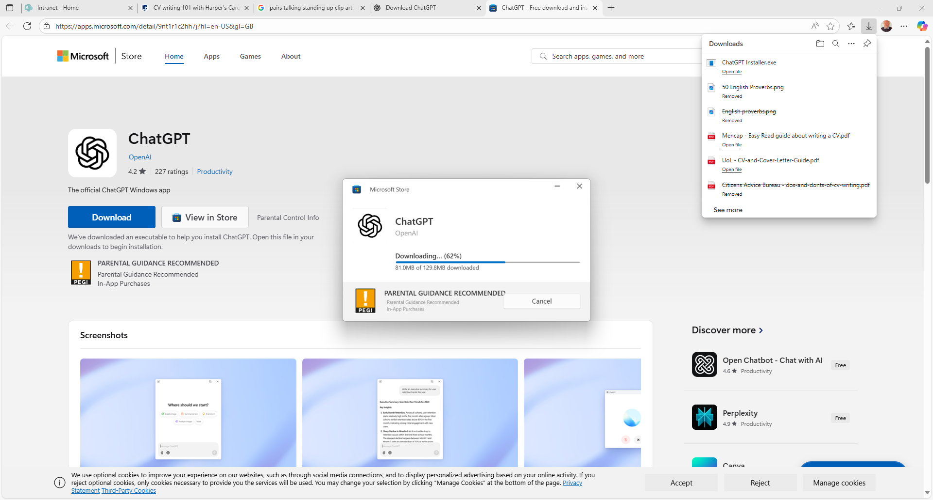
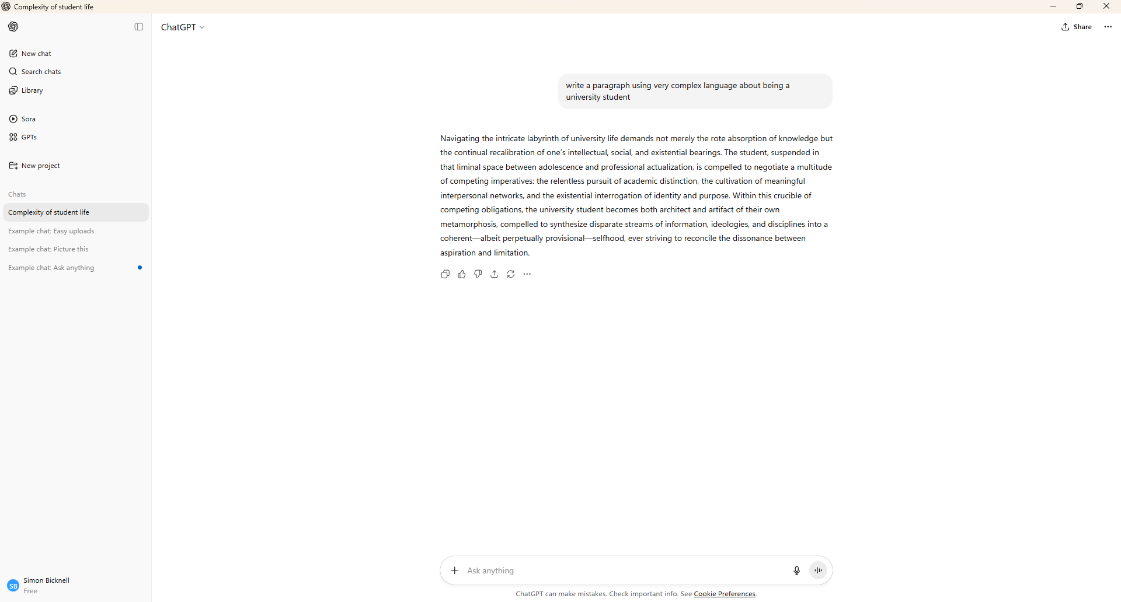


Slide 23
Using Excel Student Task 12
Creating Excel outputs using Generative AI.
Working in pairs:
Select a Generative AI platform to use.
Select a task that can be completed using Microsoft Excel, for example:
Making graphs from datasets.
Using formula for calculations.
Writing a report.
Use Generative AI to provide instructions for your fellow students on how to perform this task.
Use Generative AI to create a handout for your fellow students.
Use Generative AI to create a dataset for your fellow students (if appropriate).
Present your results to the class for feedback and discussion.

Slide 24
Tidy & Fair Data Management Principles

Slide 25

What are Tidy Data Management Principles?

Slide 26
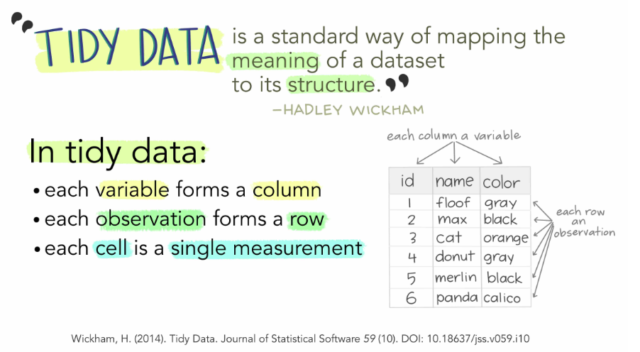
Tidy Data Management Principles
SOURCE: Tidy data principles - Data at Reed - Reed College

Slide 27
Tidy Data Management Principles
Further reading:
Wickham, H. (2014) Tidy Data. Journal of Statistical Software, 59(10), pp. 1-23.
Available at: wickham H 2014 Tidy data - Google Scholar

Slide 28
What are Fair Data Management Principles?

Slide 29

Fair Data Management Principles
SOURCE: NFDI4Chem (2025)

Slide 30
FAIR Data Principles (Findable, Accessible, Interoperable, Re-usable) support knowledge discovery and innovation as well as data and knowledge integration and promote sharing and reuse of data.
The principles help data and metadata to be ‘machine readable’, supporting new discoveries through the harvest and analysis of multiple datasets.
SOURCE: CCAFS (2025)

Slide 31
How to make data FAIR?
Findable – assigning a globally unique and eternally persistent identifier (like a DOI or Handle), describing the data with rich metadata, and making sure it is findable through disciplinary discovery portals.
Accessible – data and metadata should be retrievable in a variety of formats that are sensible to humans and machines using persistent identifiers.
Interoperable – the description of metadata elements should follow community guidelines that use an open, well-defined vocabulary.
Reusable – the data should maintain its initial richness. The description of essential, recommended, and optional metadata elements should be machine processable and verifiable, use should be easy, and data should be citable to sustain data sharing and recognize the value of data.
SOURCE: CCAFS (2025)

Slide 32
References
365 Financial Analyst (2015) Introduction to Microsoft Excel: Structure of a Microsoft Excel Spreadsheet. Available at: Introduction to Microsoft Excel: Structure of a Microsoft Excel Spreadsheet (accessed 10th September 2025).
Climate Change, Agriculture and Food Security (CCAFS) (2025) Open access and fair principles. Available at: Open Access and Fair Principles (accessed 8th October 2025).
Divecha, C.A., Tullu, M.S. and Karande, S. (2023) Utilizing tables, figures, charts and graphs to enhance the readability of a research paper. Journal of Postgraduate Medicine, 69(3), pp.125-131.
Overdog Marketing. (2022) Football fans across the generations. Available at: football fans across the generations (accessed 12th September 2025).
Ministry of Justice (2022) Use a lasting power of attorney performance data. Available at: Use a Lasting Power of Attorney Performance Data - Our live services performance data for public consumption. (accessed 12th September 2025).
NFDI4Chem (2025) FAIR data principles. Available at: FAIR Data Principles | NFDI4Chem Knowledge Base (accessed 9th October 2025).
Reed College (2025) Tidy data principles, reshaping data, and tidyr. Available at: Tidy data principles - Data at Reed - Reed College (accessed 9th October 2025).
Technology for Teachers (2018) Excel quick and simple charts tutorial. Available at: Excel Quick and Simple Charts Tutorial (accessed 12th September 2025).
Wickham, H. (2014) Tidy Data. Journal of Statistical Software, 59(10), pp. 1-23.

Slide 33
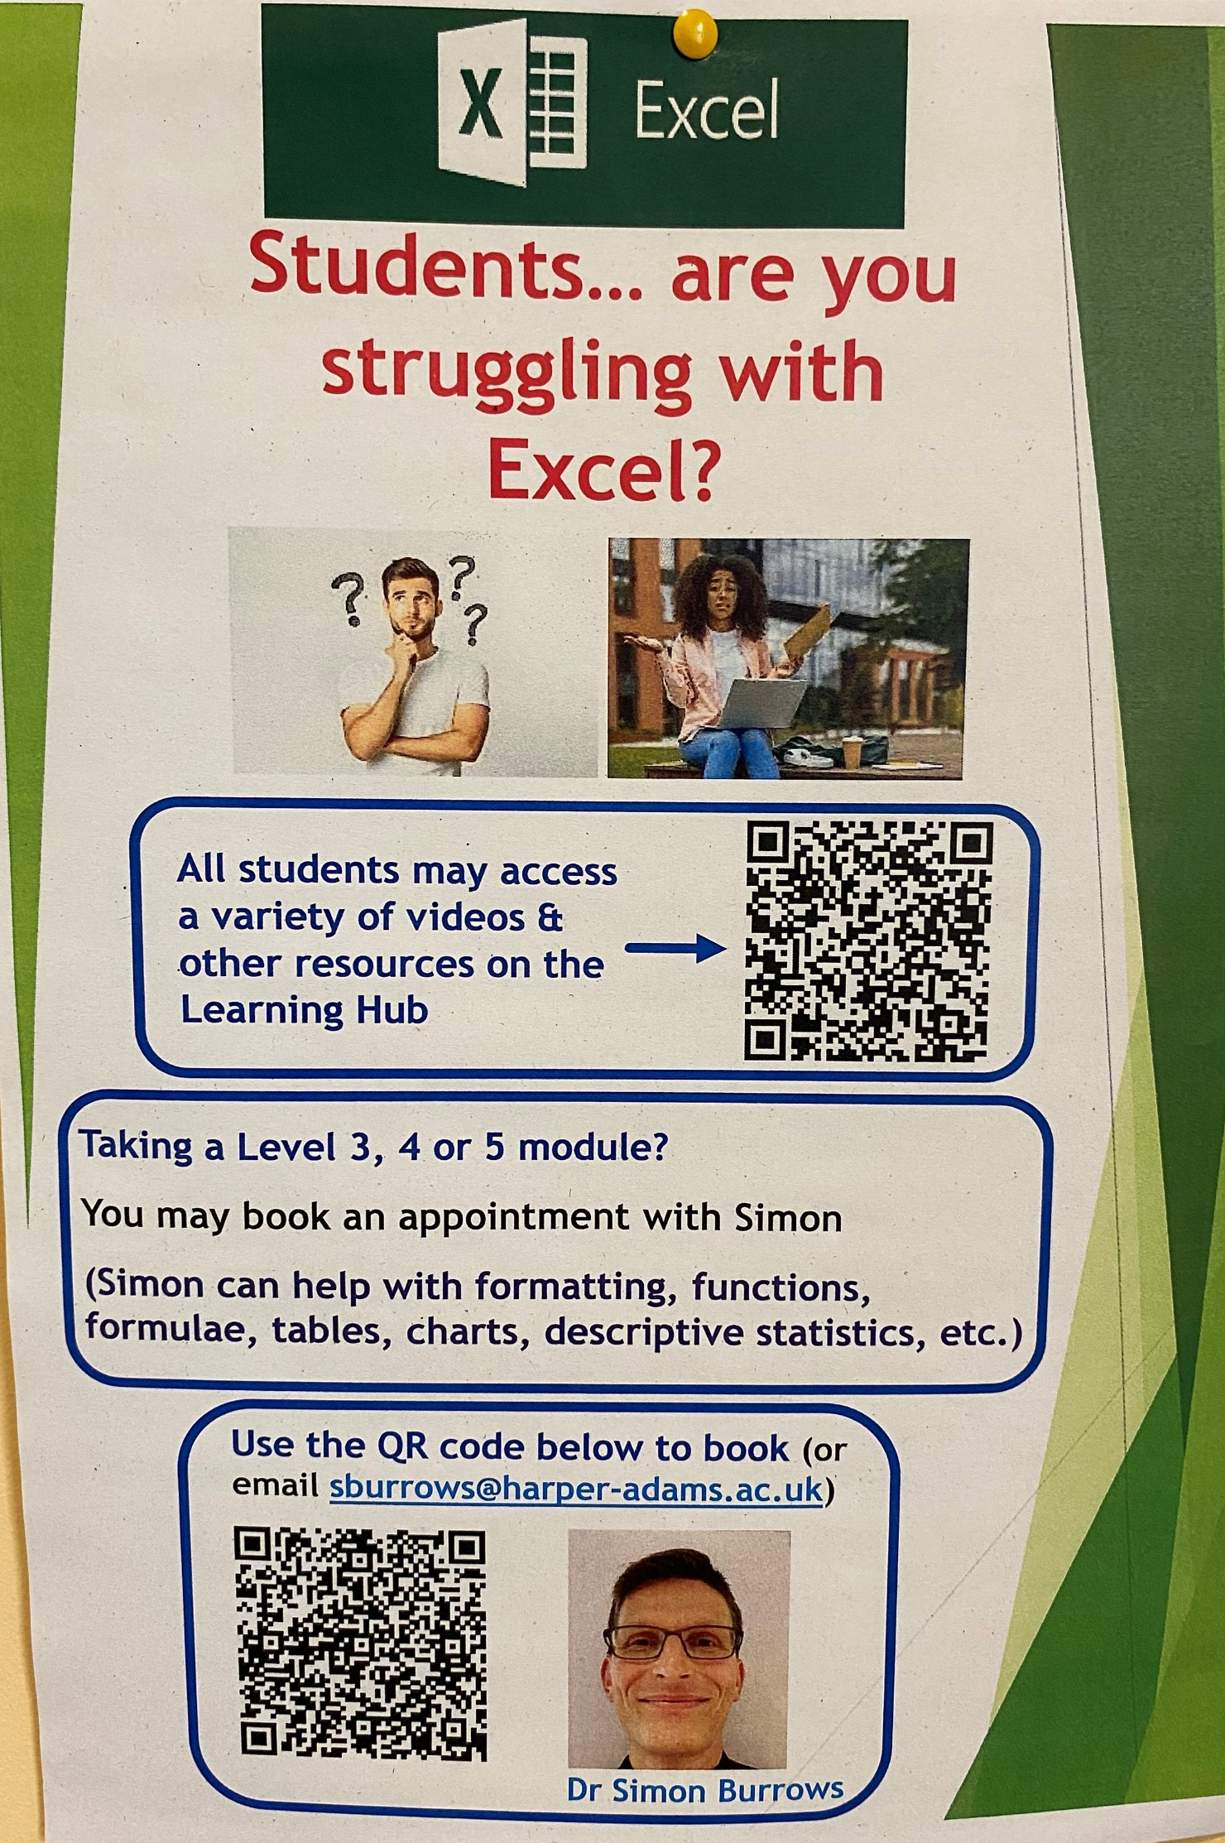
Learner Support for Students:
Dr Simon Burrows
Academic Guidance Team
Excel and Maths Support for students

